Slide 1
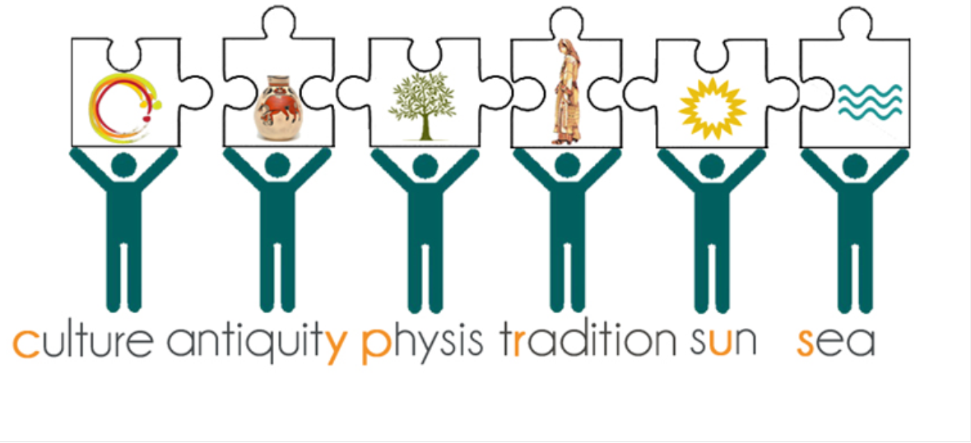
Logos Contest Tourism-Final:This logo is a combination of many student’s ideas. The sun, the sea ,the olive tree which are the basic features of the island, the traditional outfit and the Mycenaean age vases depicting the bull can smelling the lotus which is considered to be unique. As you can see the yellow letters form the word Cyprus

